Slide 1
Project 4
Presentation
Can we predict if a credit card applicant is a good customer?
Stephen Roberts
Nikita Jain
Khayria Ibrahim higo
Jessica Clewis

Slide 2
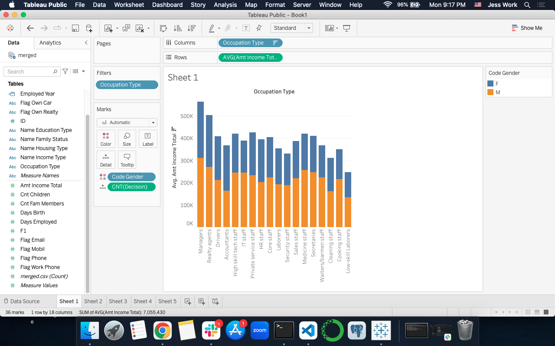
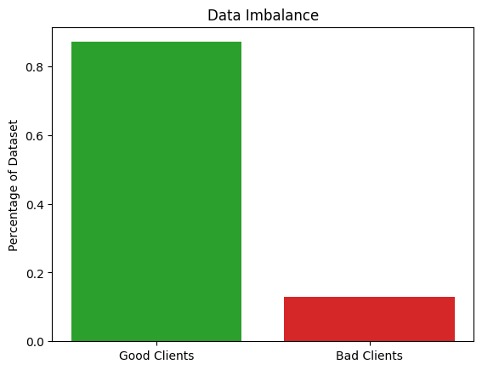
Our Dataset

Slide 3
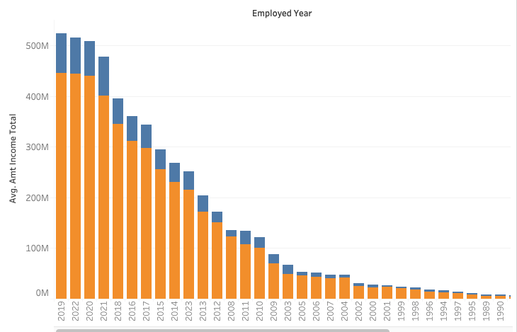
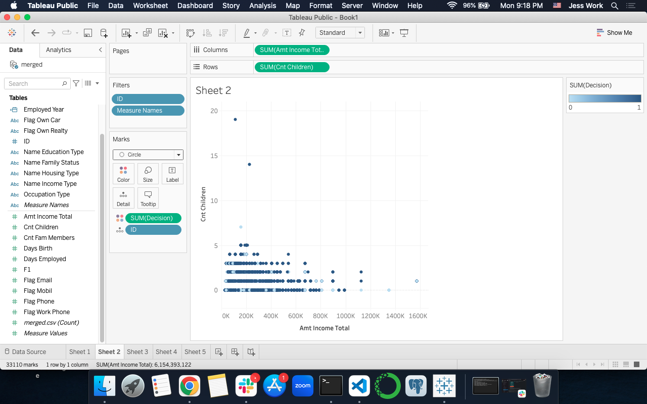
Data Insights

Slide 4
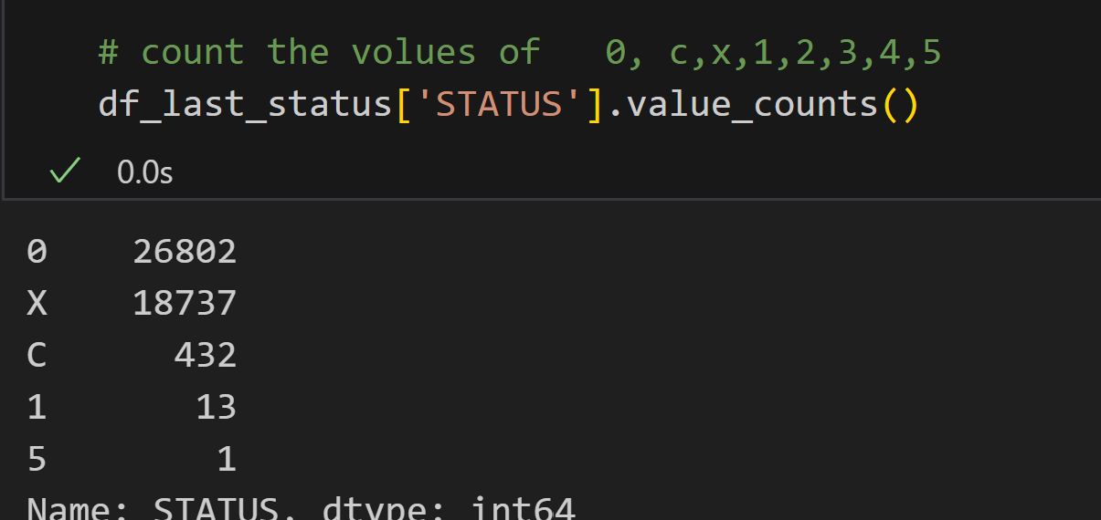
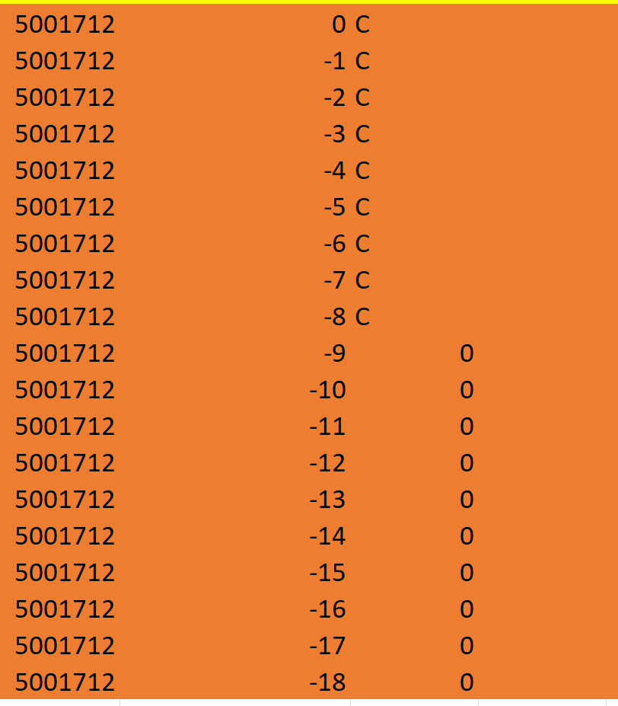
Logistic Regression Model
Sort customers value by end of the month

Slide 5
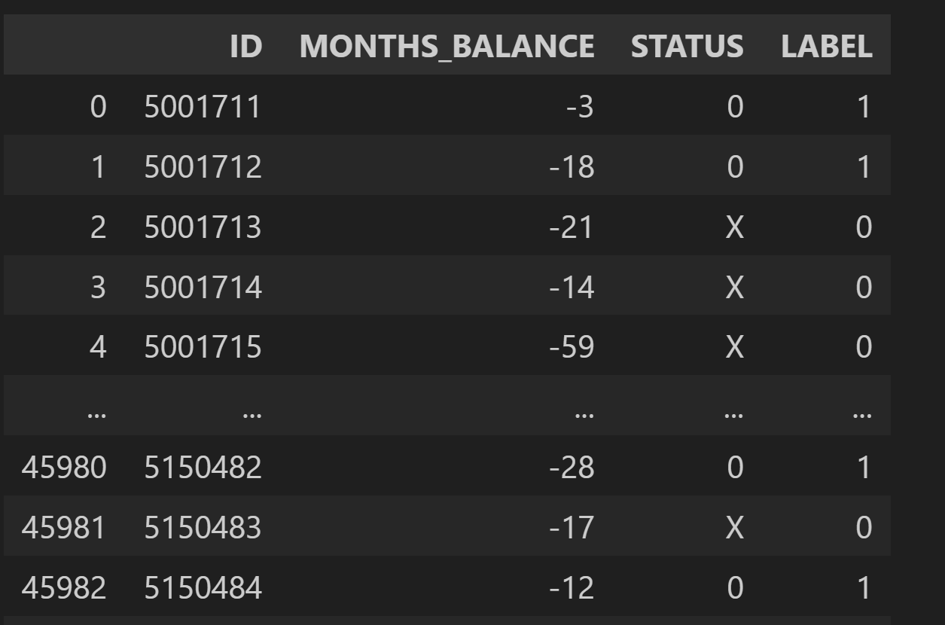
Adding New column Label 0 is Good 1 is Bad

Slide 6
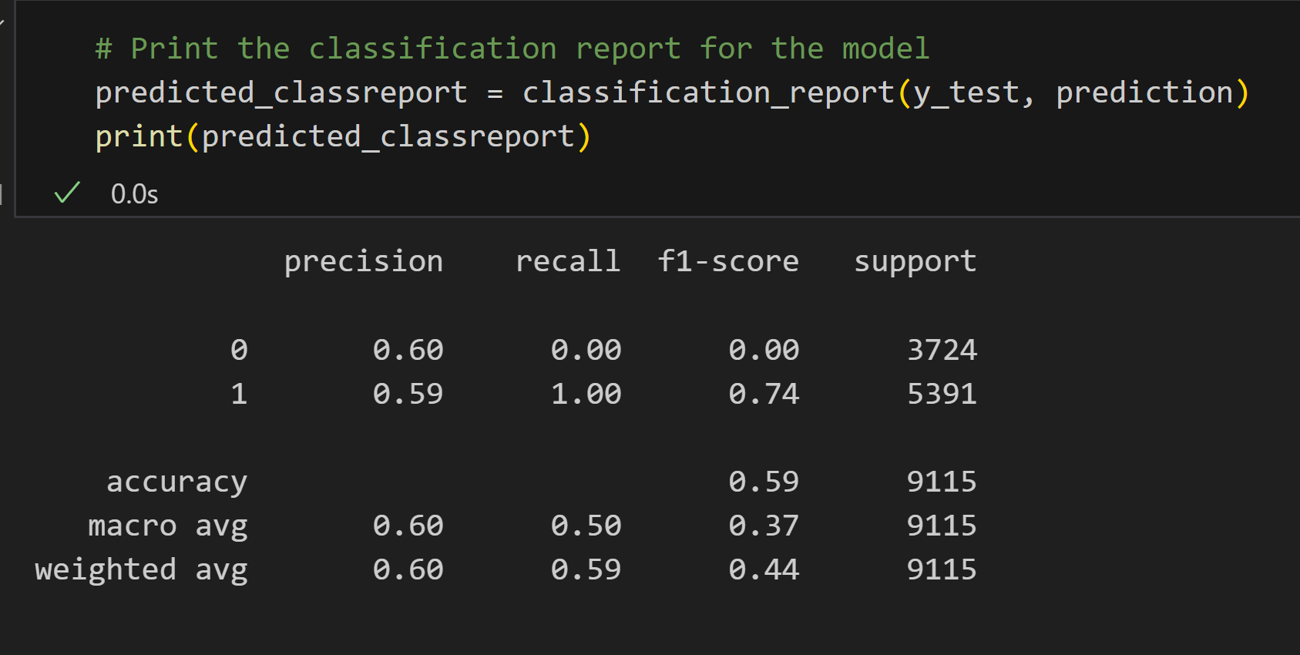
Logistic Regression Model

Slide 7
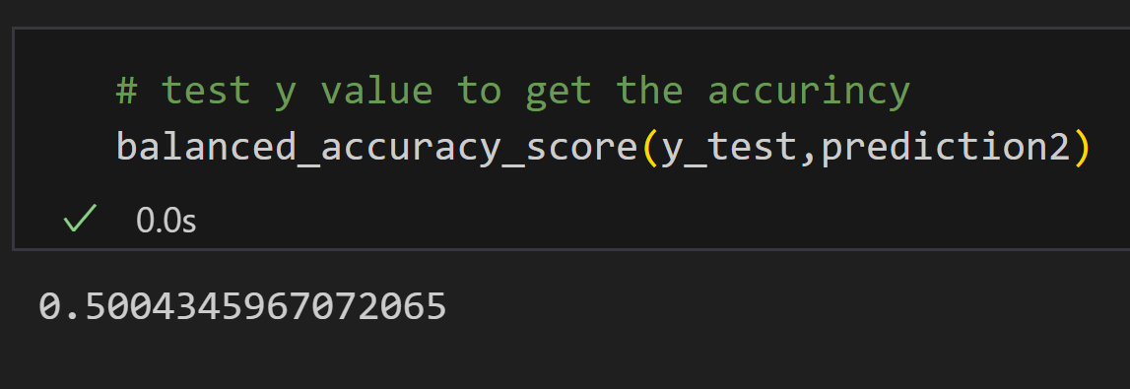
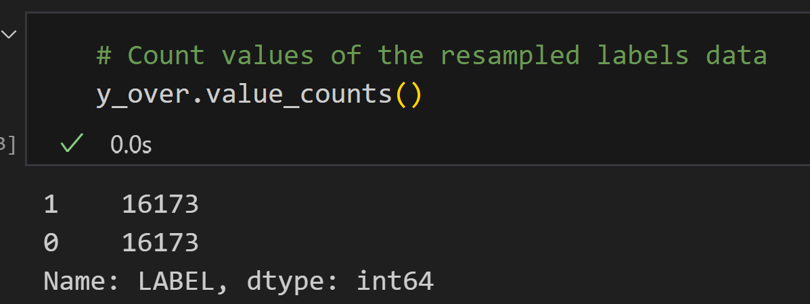
Logistic Regression Model
Over resampling the data

Slide 8
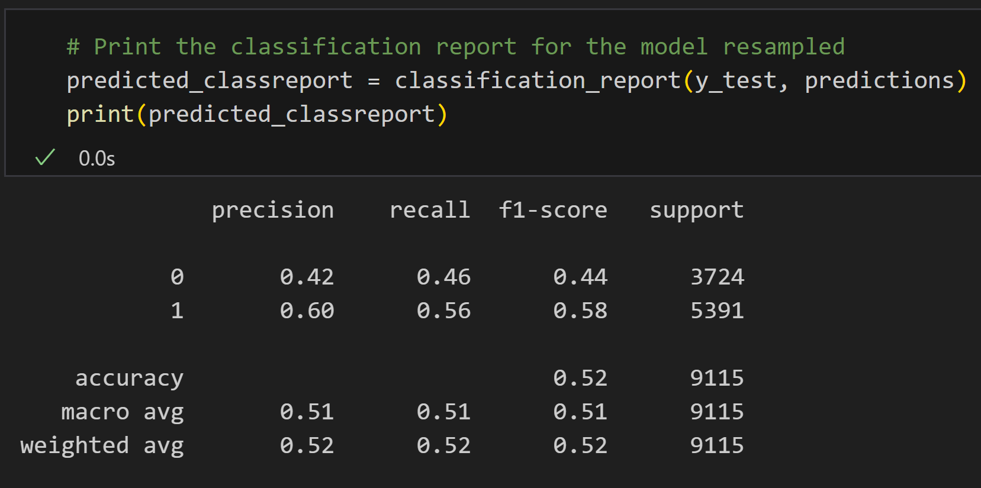
Logistic Regression Model
Model Classification Report( Resampled)

Slide 9
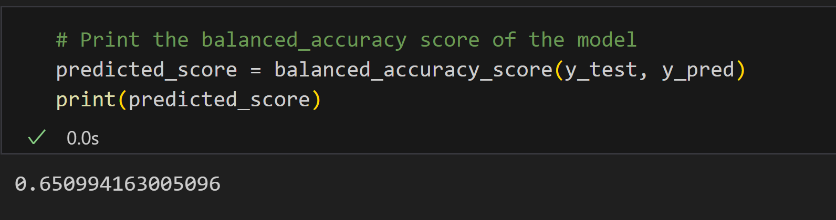
Random Forest Classification

Slide 10
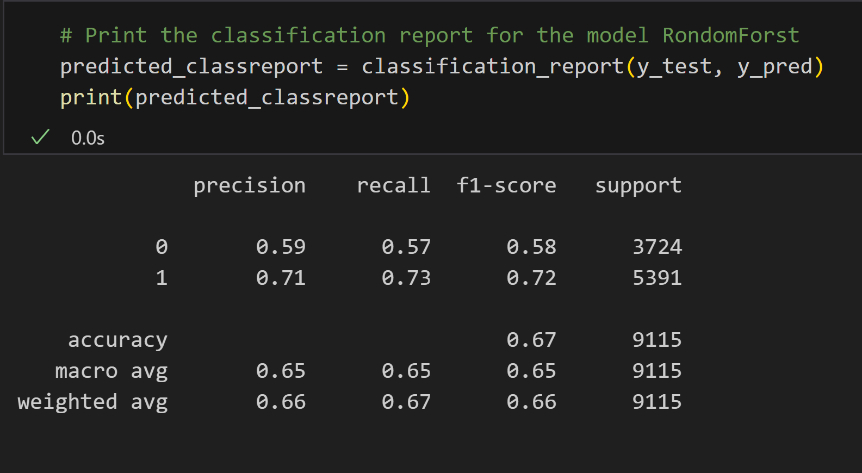
Random Forest Classification
Model Classification Report
Accuracy 67%
Precision: the model predict customers
with bad credit 71%
Recall: Bad: 73%
F1 Score: 2 * (Precision * Recall) / (Precision + Recall)
Scour: 0.71 bad
since this value is not close to 1
The model do not do good job.

Slide 11
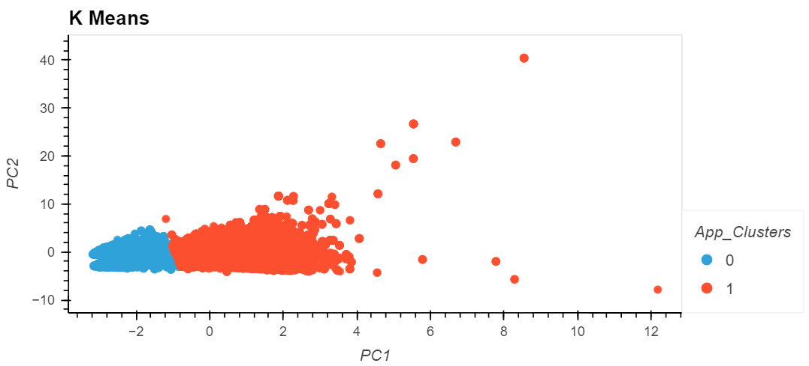
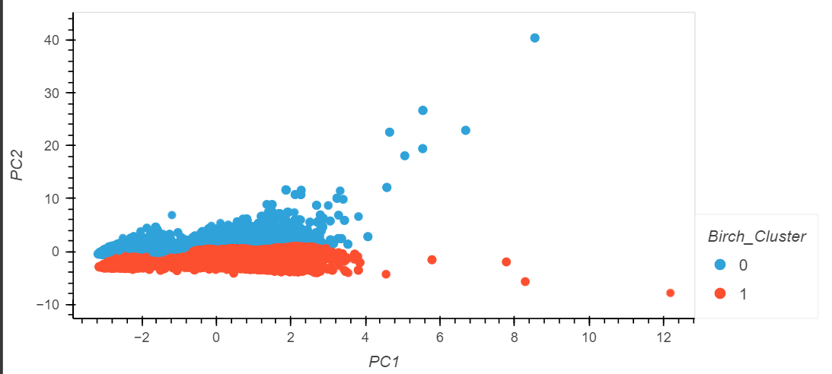
Unsupervised Learning
Clustering
K Means
Birch
Used criteria
Count of Children
Total Income
Age (Days from Birth)
Time Employed
Average Status (payment lateness)
Housing
PCA - used to reduce dimensionality for visualization
Scaled data

Slide 12
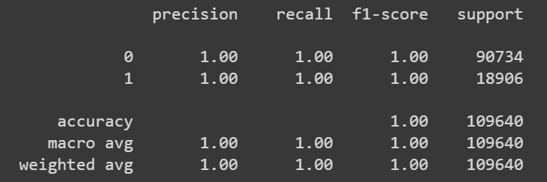
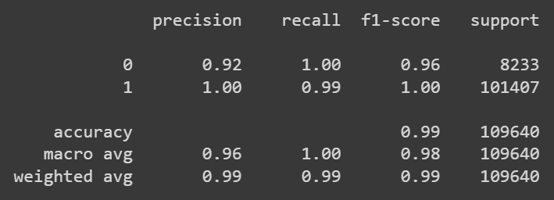
Model Results
K Means
Calinski-Harabasz - 199,807
Davies-Bouldin -0.813
Birch
Calinski-Harabasz - 210,552
Davies-Bouldin - 1.201

Slide 13
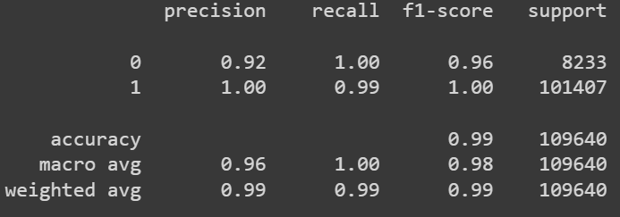
Manual Labeling
Attempted to manually classify clients
How to handle clients with no card opened?
Lack of industry knowledge
Balanced Accuracy Score - 99.6%

Slide 15
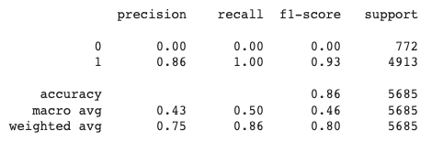
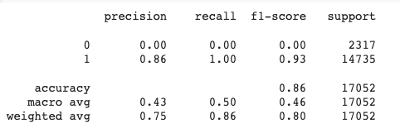
Logistic Regression Model - with original dataset
Testing & Training Classification Report

Slide 16
Neural Network Machine Learning Model

Slide 17
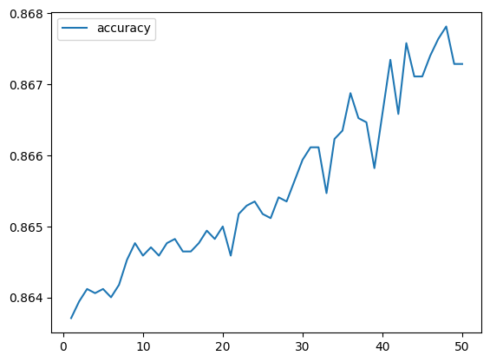
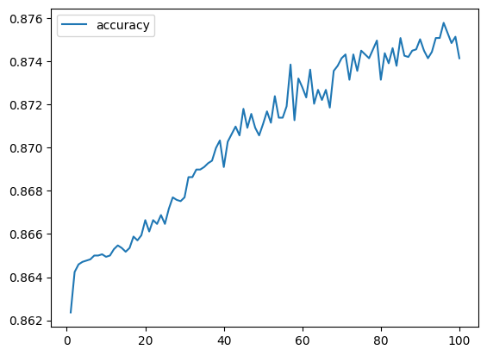
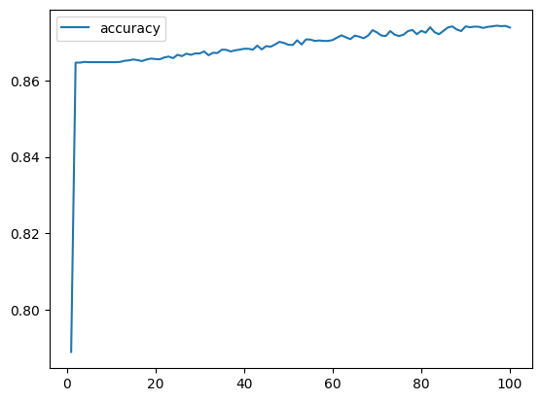
Attempts # 1, 2 & 3
Attempt # 1 layer 1 units =10 ,activation = relu layer 2 units = 20,activation = relu layer 3 units =1,activation
=sigmoid,Loss: 0.39296719431877136, Accuracy: 0.8649076223373413
Attempt # 2 layer 1 units =12 , activation = relu layer 2 units = 25 , activation = relu layer 3 units =1 , activation = sigmoid ,Loss: 0.39647939801216125, Accuracy: 0.8620932102203369
Attempt # 3 Layer 1 units =10 , activation = relu Layer 2 units =15 , activation = sigmoid layer 3 units =1 , activation = tanh ,Loss: 0.3930439352989197, Accuracy: 0.8642040491104126

Slide 18
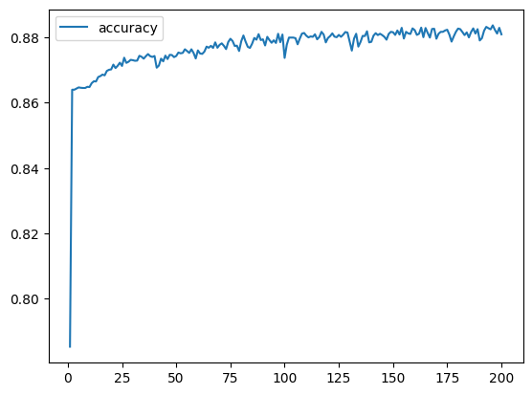
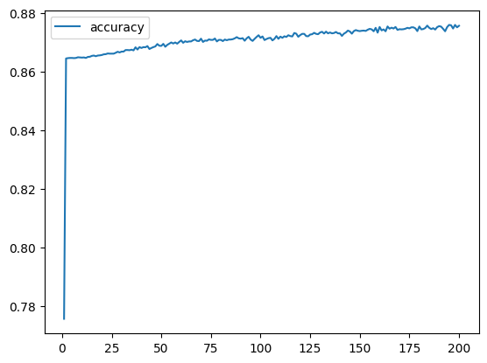
Attempt # 4 & 5
Attempt # 4 layer 1 unit =15 ,activation = relu layer 2 unit =30 ,activation = relu layer 3 unit =1 , activation = tanh Loss: 0.44463440775871277, Accuracy: 0.8605101108551025
Attempt # 5 layer 1 unit =10 ,activation = sigmoid layer 2 unit =15 ,activation = relu layer 3 unit =1 , activation = tanh,Loss: 0.3977033197879791, Accuracy: 0.865787148475647

Slide 19
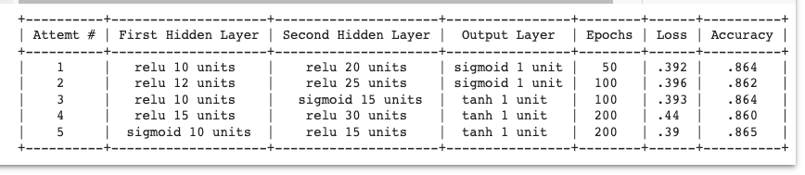
Neural Network Model Performances

Slide 20
Best Result
Attempt # 1
layer 1 units =10 , activation = relu layer 2 units = 20 , activation = relu layer 3 units =1 , activation = sigmoid
Loss: 0.39296719431877136, Accuracy: 0.8649076223373413

Slide 21
Conclusions
Difficult to get a model with a high level of predictive power
Unbalanced dataset
Lack of industry knowledge with an unlabeled dataset
Data categories fell on a spectrum rather than distinct groupings

